Slide 1

Introduction to Genetic Algorithm（遗传算法）
Yong Wang
School of Automation
Central South University
ywang@csu.edu.cn
https://intleo.csu.edu.cn/

Slide 2
Outline of My Talk
Genetic algorithm
Real-coded genetic algorithm
How to program genetic algorithm in Matlab

Slide 3
Outline of My Talk
Genetic algorithm
Real-coded genetic algorithm
How to program genetic algorithm in Matlab

Slide 4
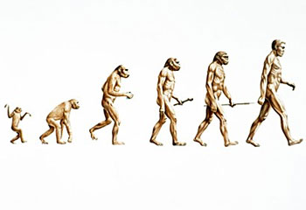
Introduction (1/2)
What is genetic algorithm (GA)?
  Proposed by Professor J. Holland in the 1960s
  Take the inspiration from Darwin’s theory of evolution, i.e., natural selection and survival of the fittest in the biological world (物竞天择，适者生存)

Slide 5
Introduction (2/2)
The basic component of genetic algorithm
  chromosome（染色体） or string（串）, which is also called an individual in a population
string position
(locus)
string
(chromosome)
1 2 3 4 5 6 7 8 9 10 11 12 13 14 15 16
0
0
1
1
1
12
0
1
0
1
1
1
0
1
0
0
1
24
feature
(gene)
feature value
(allele)
Schema
Please note that the next three slides were providedby Dr. Chang Wook Ahn

Slide 6
Classic Genetic Algorithm (1/3)
Three operators of genetic algorithm
1. Selection（选择）:
→ Individuals are copied according to their fitness function values
→ An artificial version of natural selection
→ Roulette wheel selection（赌轮选择）, Tournament selection（联赛选择）
1010101010
1110001000
0011011100
0100001111
1101100011
0011101010
1010101010
0011011100
0100001111
1101100011
0011011100
1101100011
Roulette wheel selection

Slide 7
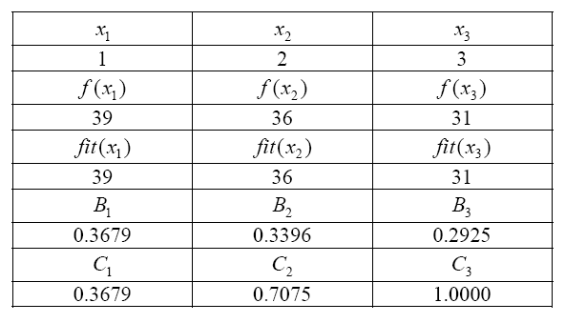
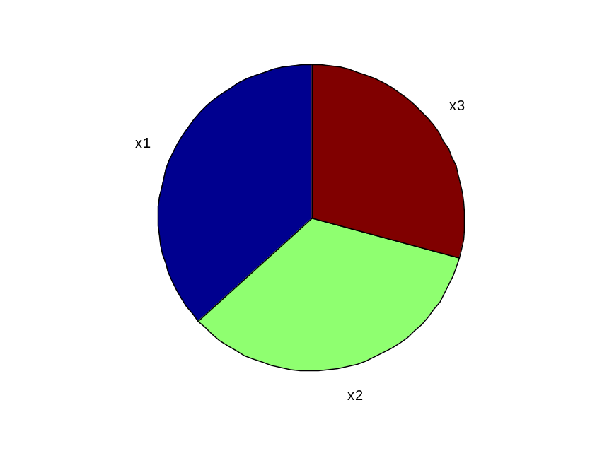
Classic Genetic Algorithm (2/3)

Slide 8
Classic Genetic Algorithm (3/3)
2. Crossover（交叉）:
→ Randomly select two individuals from the population
→ After choosing a crossover site at random, the information of the two
individuals are exchanged with probability p_{c}
3. Mutation（变异）:
→ For each individual, each bit is mutated with probability p_{m}
→ when implementing the mutation, change a “1” to a ”0” or visa versa
1110001000
0100001111
1110001000
1110001111
0100001000
1110101000

Slide 9
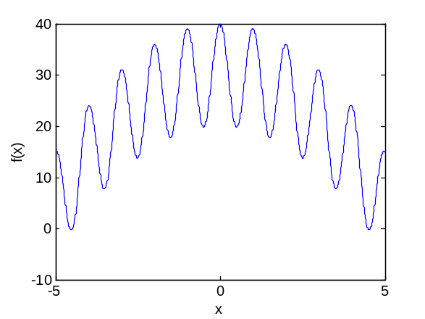
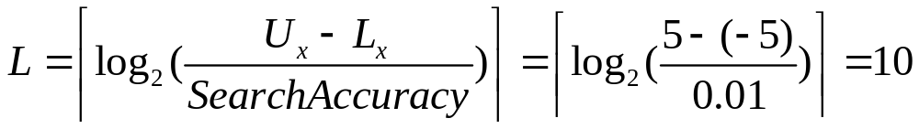
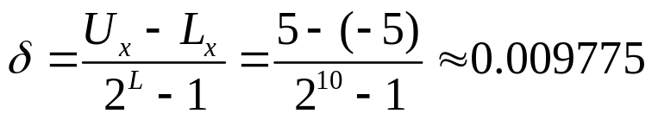
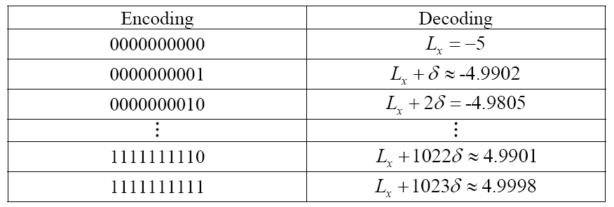
An Example of Classic Genetic Algorithm (1/5)
Encoding（编码） and decoding（解码）

Slide 10
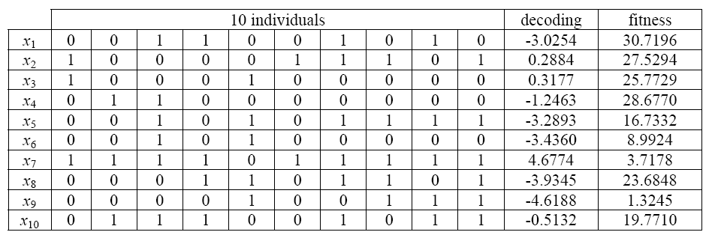
An Example of Classic Genetic Algorithm (2/5)
elitist（精英）
The initial population（初始群体）

Slide 11
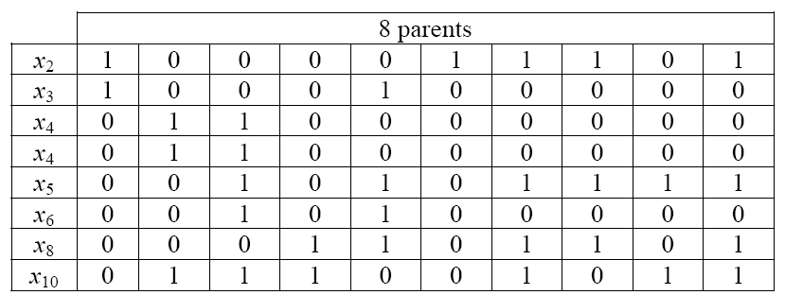
An Example of Classic Genetic Algorithm (3/5)
Selection

Slide 12
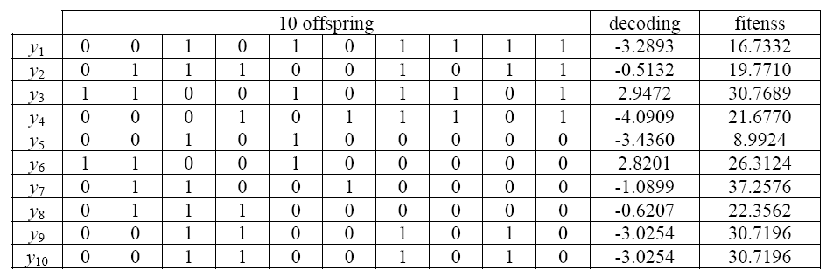
An Example of Classic Genetic Algorithm (4/5)
Crossover and mutation

Slide 13
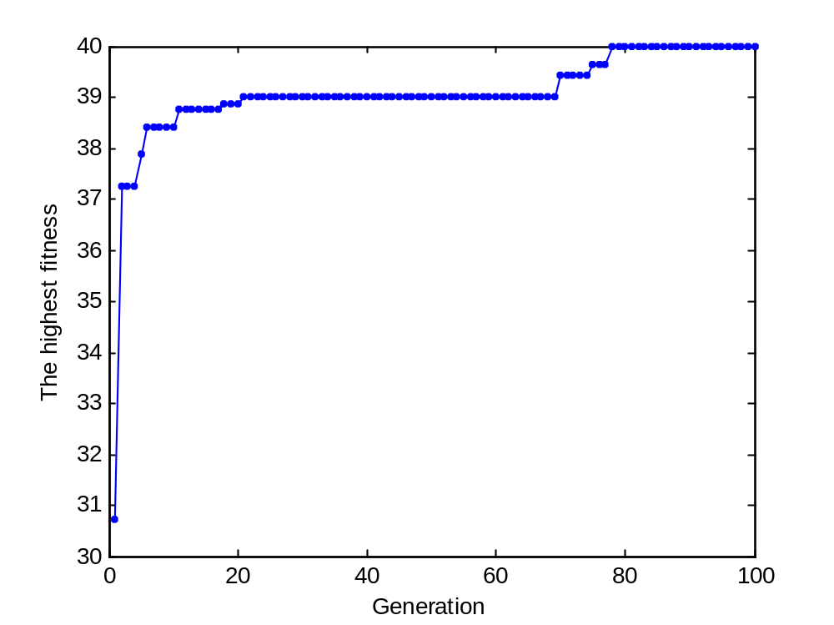
An Example of Classic Genetic Algorithm (5/5)
Convergence curve（收敛曲线）

Slide 14







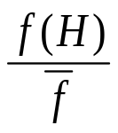
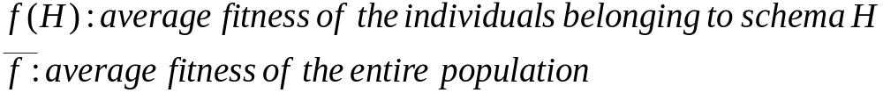
Schema Theorem (1/3)
Please note that the next three slides were provided by Dr. Chang Wook Ahn
Order（阶） of schema H:
- Number of the fixed positions
*011*0
*****0
Length（长度） of schema H:
- The distance between the first and last specific positions
*011*0
*****0
How many expected number of schema H will be inherited to the
next generation（下一代）?
The survival probability under selection:
where

Slide 15





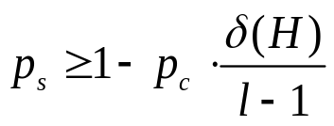

Schema Theorem (2/3)
Consider the following:
0111000
011|1000
*1****0
*1*|***0
Schema will be
destroyed!
***10**
***|10**
If the crossover site is selected uniformly among L-1 = 7-1 = 6, then
the probability that schema is destroyed:
The survival probability under crossover:
where

Slide 16




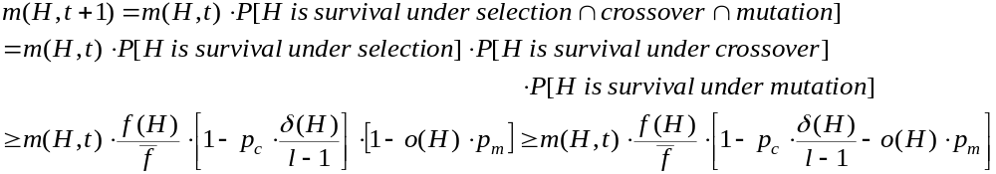
Schema Theorem(3/3)
Mutation is the random alteration of a single bit with probability .
Single bit survives with probability .
The survival probability under mutation:
Schema H receives an expected number of copies in the next generation:
Low-order, short, and high-fitness schemata receive exponential increasing in subsequent generations!

Slide 17
Outline of My Talk
Genetic algorithm
Real-coded genetic algorithm（实数编码遗传算法）
How to program genetic algorithm in Matlab

Slide 18
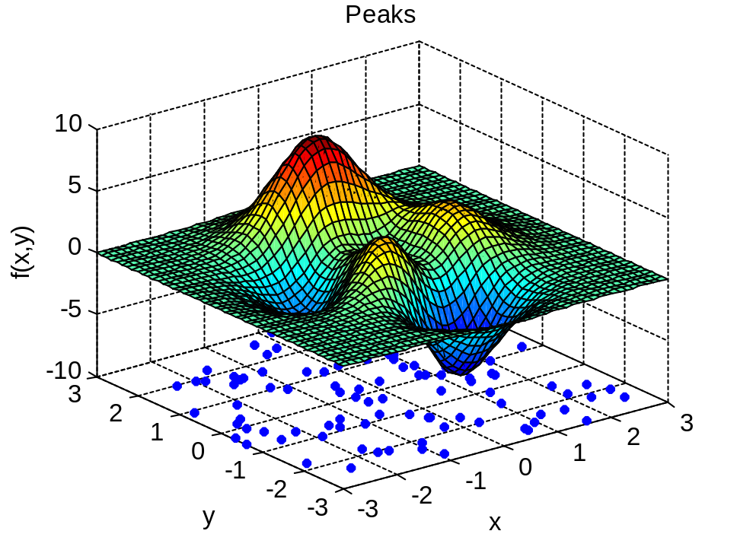
Real-coded Genetic Algorithm (1/2)
The initial population（初始群体）

Slide 19
Real-coded Genetic Algorithm (2/2)
Algorithmic framework
Crossover operator
B
Selection
Plan
Generation
Plan
Q
C
①
②
③
Replacement
Plan
R
R’
Update
Plan
④
K. Deb. A population-based algorithm-generator for real-parameter optimization, Soft Computing, vol. 9, no. 4, 2005, pp. 236-253.

Slide 20
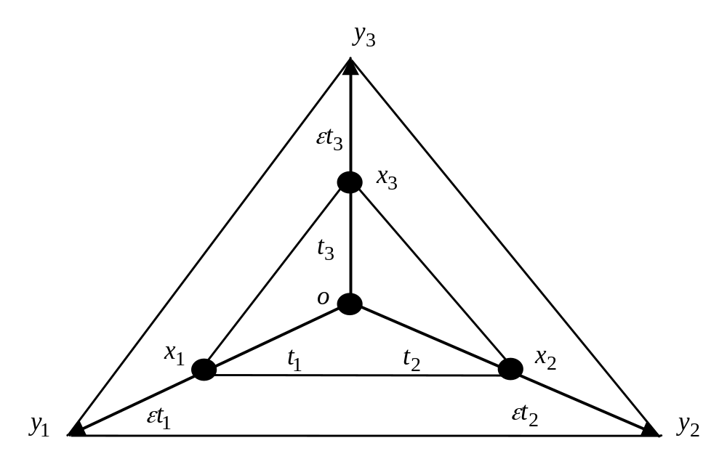
Crossover Operator
The offspring generated by simplex crossover (SPX，单形交叉)
Multi-parent crossover
H. Kita. A comparison study of self-adaptation in evolution strategies and real-coded genetic algorithms, Evolutionary Computation, 2001, 9(2): 223-241

Slide 21
Outline of My Talk
Genetic algorithm
Real-coded genetic algorithm
How to program genetic algorithm in Matlab

Slide 22
How to program genetic algorithm in Matlab (1/6)
When programming binary-coded genetic algorithm, the following five main steps are needed:
  Encoding（编码）
  Decoding（解码）
  Selection（选择）
  Crossover（交叉）
  Mutation（变异）
刘国华, 包宏, 李文超. 用MATLAB实现遗传算法程序. 计算机应用研究, 2001, 18(8): 80-82.

Slide 23
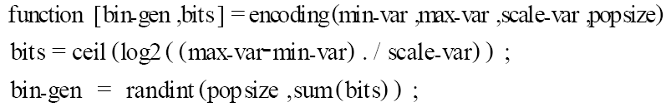
How to program genetic algorithm in Matlab (2/6)
Encoding

Slide 24
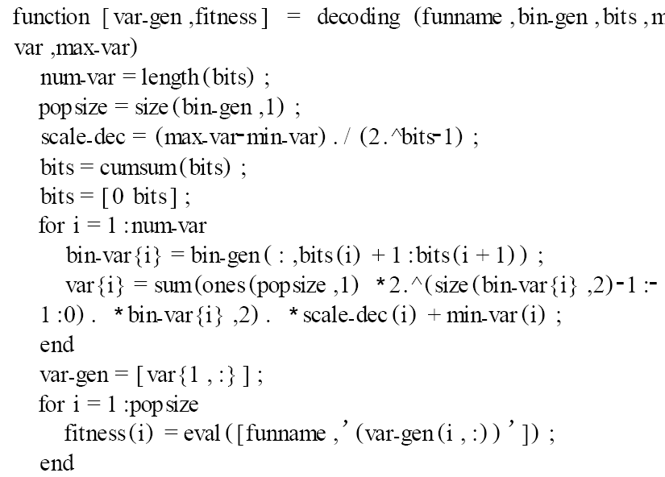
How to program genetic algorithm in Matlab (3/6)
Decoding

Slide 25
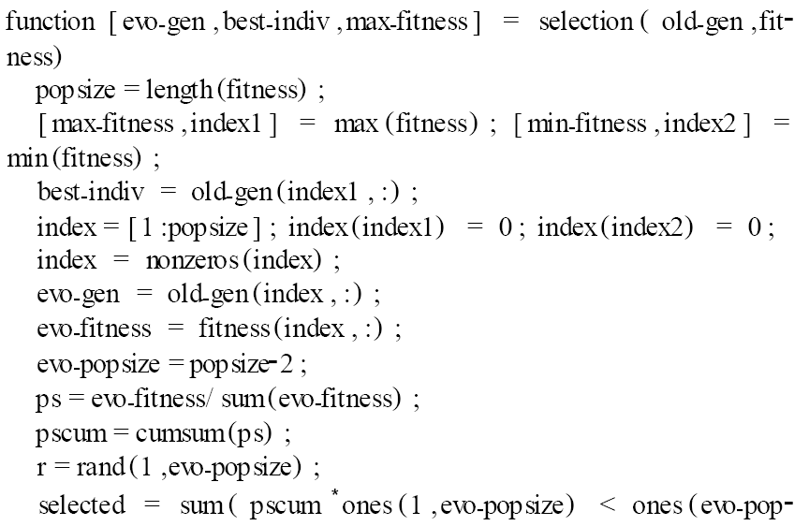

How to program genetic algorithm in Matlab (4/6)
Selection

Slide 26
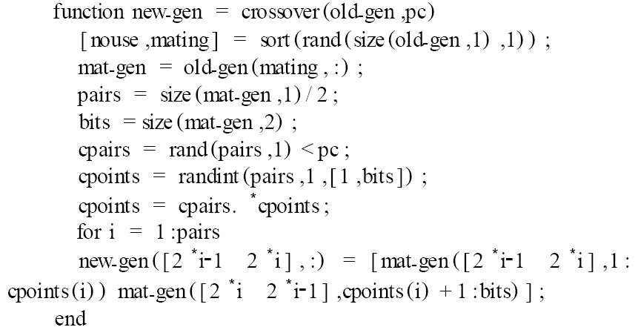
How to program genetic algorithm in Matlab (5/6)
Crossover

Slide 27
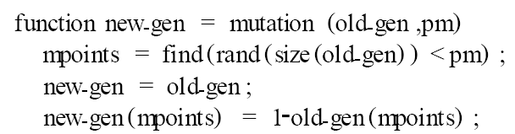
How to program genetic algorithm in Matlab (6/6)
Mutation

Slide 28
Keywords
Binary-coded genetic algorithm（二进制编码遗传算法）
Real-coded genetic algorithm（实数编码遗传算法）
Chromosome （染色体）
Schema（模式）
Elitist（精英）
Multi-parent crossover（多父体交叉）

Slide 29
Reading Materials
J. Holland. Adaptation in natural and artificial systems. Ann Arbor: The University of Michigen Press, 1975.
K. Deb, A, Anand, and D, Joshi. A computationally efficient evolutionary algorithm for real-parameter optimization, Evolutionary Computation, 2002, 10(4): 371-395.
K. Deb. A population-based algorithm-generator for real-parameter optimization. Soft Computing, 2005, 9(4): 236-253.
H. Kita. A comparison study of self-adaptation in evolution strategies and real-coded genetic algorithms, Evolutionary Computation, 2001, 9(2): 223-241
姚新, 陈国良, 徐慧敏, 刘勇. 进化算法研究进展. 计算机学报, 1995, 18(9): 694-706.
刘国华, 包宏, 李文超.用MATLAB实现遗传算法程序. 计算机应用研究, 2001, 18(8): 80-82.

Slide 30


